Slide 1
Visibility of What? Sociological and historical discussions of how we make and use data in clinical & biomedical knowledge production?
rectangle
circle
Max Perry / Science, Technology & Innovation Studies/ University of Edinburgh / Email: Max.Perry@ed.ac.uk

Slide 2

Seminar plan for today
Introductions
Data, knowledge, truth / Sociology of databases
Discussion
Covid death data (David Armstrong article)
Discussion on data
Broader discussion on ethics of knowledge production.
Notes:
I’m not going to give you a full history of the sociology of knowledge, nor of the sociology of data, nor indeed of a social science of healthcare data.
Instead, what I want today to do, is to open up particular problematizations about how we produce data, how we use it, and what it is to use data to claim something to be true of the world.
This is going to work best as a discussion session. That said, I’m aware I’m going to be talking in a language that’s a little different to yours. So I’ll open up for 30 minutes-or-so talking about data from a social science perspective or at least from the perspective through which I think about it.
What is data?
What is it you are doing a science of?
I used to ask this question of my sociology students – a science of society. Is difficult to describe what a society is. But we broadly know what it is, and we know what ‘health’, and we know what ‘biomedicine’ is. Do we know what data is?
Latour – Boa Vista essay / reduction amplification. Uses and losses of data.

Slide 3
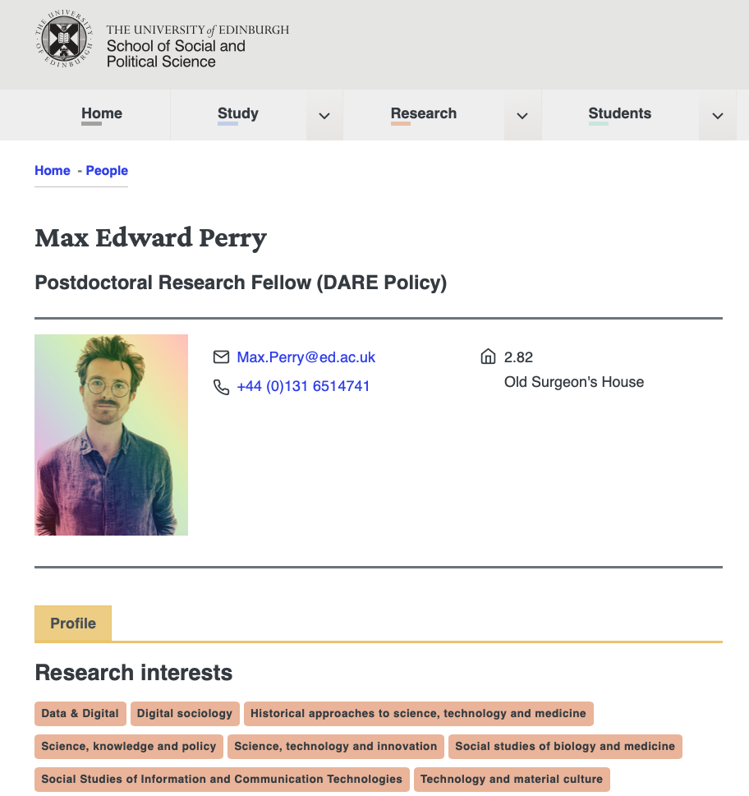
Sociology
10 years NHS/Healthcare/IT
MSc Social Science Research
PhD: sociology of medical records
Postdoctoral researcher: Policy data-led healthcare.

Slide 4
Collect some data….
Name
Interests/specialisms
Social science/reading/questions for the seminar.
what is data?

Slide 5
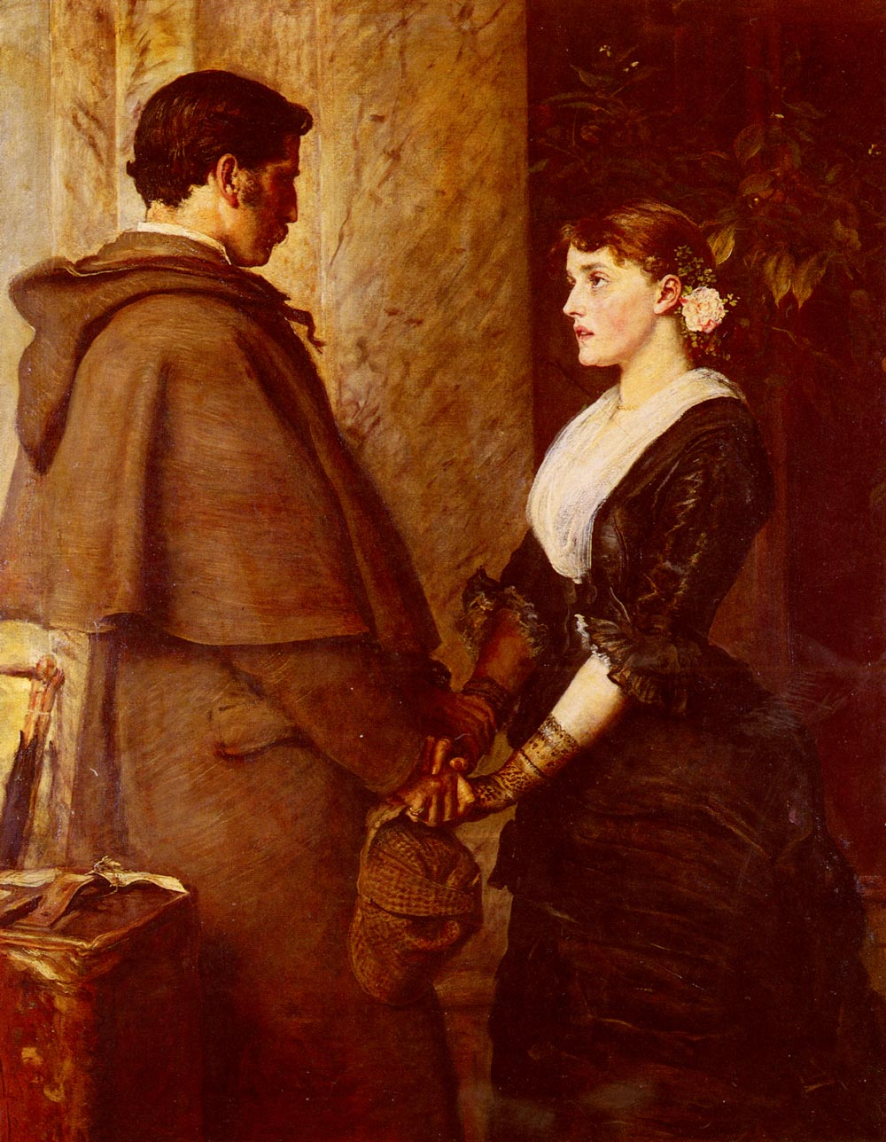
Data/datum (something given)
Sociology of knowledge, how do we know about the world? What is the role of data? How do we create data? – Who gives it, and how is it taken?
Data-base.
Data is not extracted from reality but is transferred/translated/transformed.
Data, as conceived in ‘text-books’ assumes what Deleuze (1992) has referred to as a numericalization of reality.
‘Both as an ex-physicist and as an historian of physical science I feel sure that, for at least a century and a half, quantitative methods have indeed been central to the development of the fields I study. On the other hand, I feel equally convinced that our most prevalent notions both about the function of measurement and about the source of its special efficacy are derived largely from myth.’
(T. Khun. 1961. The Function of Measurement in Modern Physical Science.)

Slide 6
Datafication (Beaulieu & Leonelli, 2021) / Intensified data sourcing (Hoeyer, 2016 & 2023)
We live in a time of data abundance.
This abundance is the product of a concerted building of data infrastructure, and of laborious ‘data work’.
Management of database infrastructures and the data they house is a product of complex human and technological labour.
The more such processes are automated, the more complex and specialised the oversight requirements are.
As data and their infrastructures increase, and the role they play in life and decision making increases, the stakes of maintaining and managing them become higher, more contingent and the risks of failure grow increasingly catastrophic. (see: Downer, 2024)
How do we make a data infrastructure ultra-reliable?
How and of what does data speak?
Think about the algorithms you interact with each day, and consider how frequently you are served marketing information that is ‘stupid’.
These algorithms are clearly not stupid though?
Data can be both intelligent and stupid at the same time.
Data can thus be accurate, and inaccurate. Can speak truthfully, and deceptively.
The truthfulness/deceptiveness of data is not delimited to its use, it is a feature of transformation of reality into abstracted ‘data’.

Slide 7
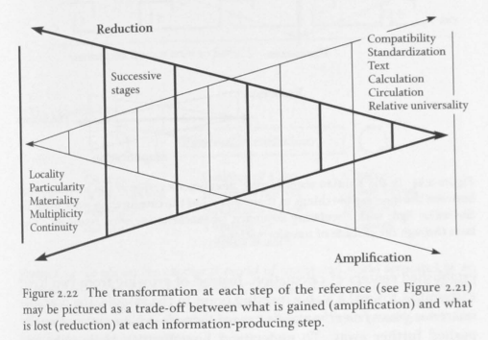
Source: Latour, B. (1999) Pandora’s Hope: Essays on The Reality Of Science Studies. Cambridge, MA: Harvard University Press.

Slide 8
Circulation, intensification & paradox.
Data is valuable because it allows the circulation of certain established transformations.
We can talk about how many patients have diabetes.
We can talk about whether they have insulin controlled diabetes, whether they have ‘type 1’ or ‘type 2’ diabetes.
We can assign a cost value for a surgical intervention and automate payment to hospitals who perform that surgical intervention (see: ICD-10)
The perceived value of this numericalization/datafication has led to a great proliferation in what is measured, as well as attempts to retain and reuse these measurements (as data)
Medical records are used for clinical audit & for biomedical research.
Programs are underway to build an infrastructure to house NHS data, which can then be used for the purposes of biomedical research & medtech development at scale (see: NHS England SDE program & Scotland data havens)
Numericalization/datafication is a deeply context dependant enterprise. This is why ‘provenance’ is so vital to data scientists, and why an ‘ontology’ is so vital to database engineers.
Berg (1997) proposed a ‘law of medical information’
Data are ‘multiple’ (Mol, 2002).
Intensified data sourcing deepens the political salience of this multiplicity (Hoeyer, 2023).

Slide 9
DATAFICATION/NUMERICALIZATION/INTENSIFIED DATA SOURCING

Slide 10

HEALTHCARE DATA….
SNOMED CT, ICD10, SECURE DATA ENVIRONMENTS, ELECTRONIC MEDICAL RECORDS, FEDERATED DATA PLATFORMS.
DATA FOR WHAT?

Slide 11
BREAK

Slide 12
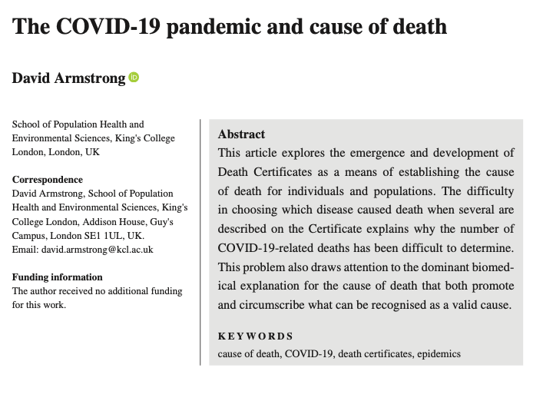
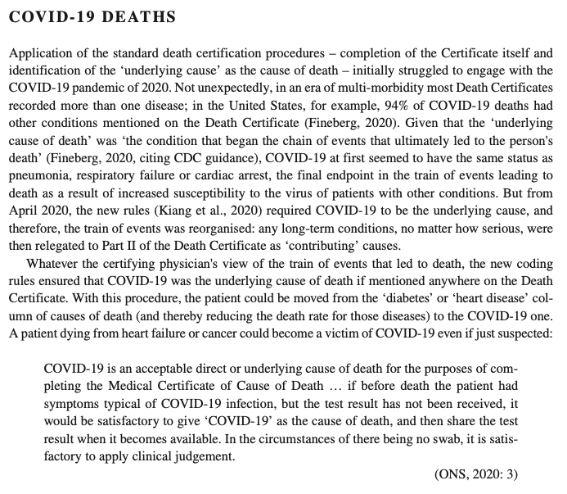
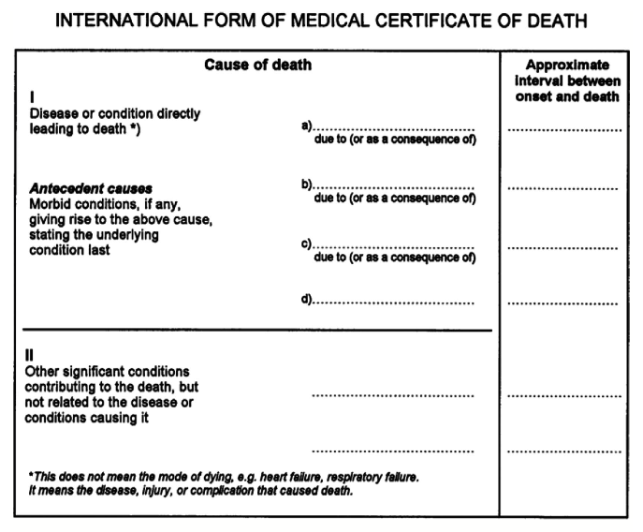

Slide 13
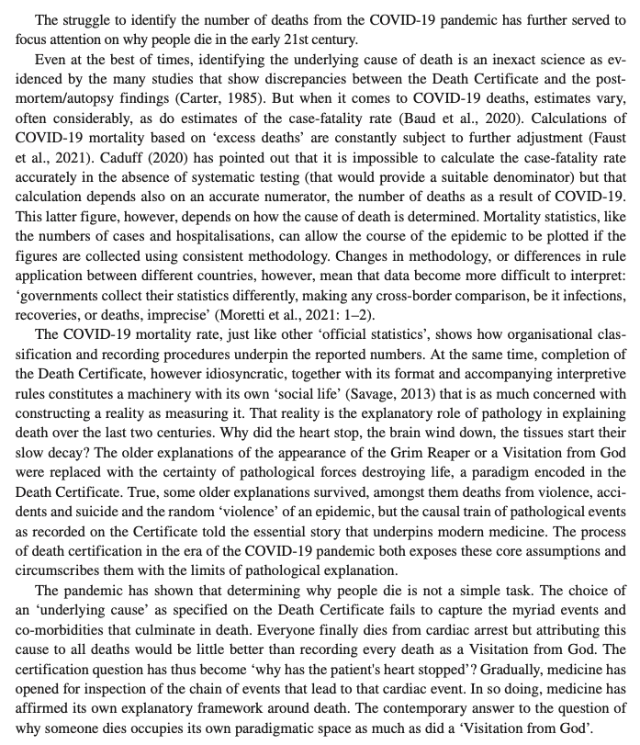

Slide 14
Source: Latour, B. (1999) Pandora’s Hope: Essays on The Reality Of Science Studies. Cambridge, MA: Harvard University Press.

Slide 15
SOME PROVOCATIONS…

Slide 16
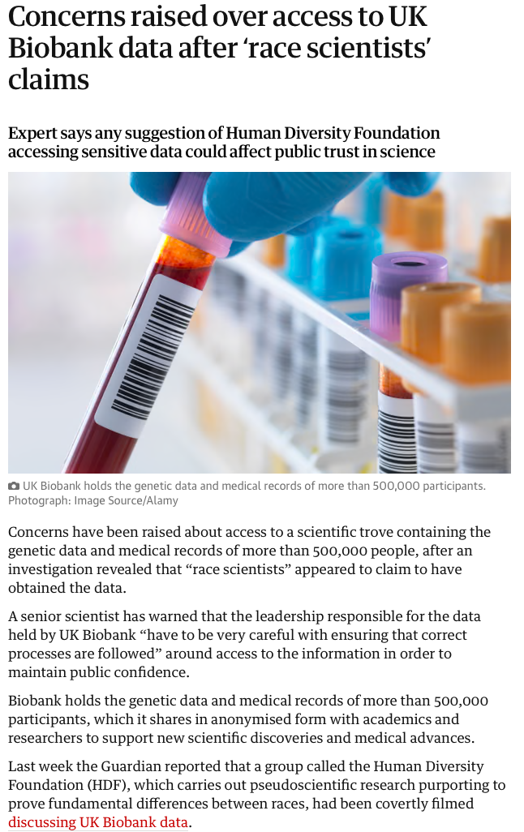
An ethics of knowledge production.

Slide 17

Standardization in clinical work
Data-Driven Healthcare….
‘I don't see an alternative.... How can we insert the evidence base, the science if you will, into every care decision that a physician makes? That is ultimately what [Electronic Health Records] offer when they are operating at their height…An ability to ensure that every action taken in
the care of a patient is based on some science and not the opinion of a physician who thinks "Well I've done it that way for 25 years, and I don’t really care what the literature shows.”’
(George Gellert in Gellert et al. 2017)

Slide 18
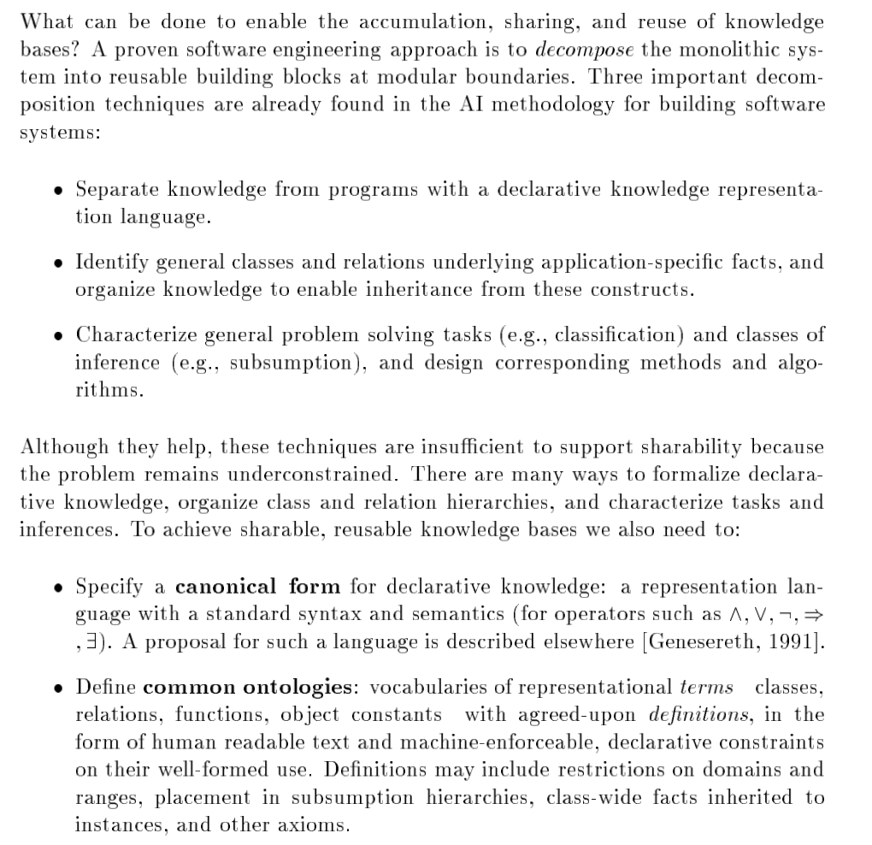
Gruber, T.R., 1991. The role of common ontology in achieving sharable, reusable knowledge bases. Kr, 91, pp.601-602.
Notes:
Yes
John Everett Millais
Date: 1877
These are, perhaps, fairly trite starting points?

Slide 19

THANKS.
Notes:
‘We could have been anything that we wanted to be (red version)’, Ruth Ewan, 2011 | Tate

